Slide 1
Python
Session – 11
Date – 08th June, 2022

Slide 2
Fancy Decorators

Slide 3
Class Decorators
Python provides two ways to decorate a class. Firstly, we can decorate the method inside a class; there are built-in decorators like @classmethod, @staticmethod and @property in Python. The @classmethod and @staticmethod define methods inside class that is not connected to any other instance of a class. The @property is generally used to modify the getters and setters of a class attributes. Let’s understand it by the following example:
Example: 1- @property decorator - By using it, we can use the class function as an attribute. Consider the following code:
class Student:
def __init__(self,name,grade):
self.name = name
self.grade = grade
@property
def display(self):
return self.name + " got grade " + self.grade
stu = Student("John","B")
print("Name:", stu.name)
print("Grade:", stu.grade)
print(stu.display)

Slide 4
Class Decorators
Example:2 - @staticmethod decorator- The @staticmethod is used to define a static method in the class. It is called by using the class name as well as instance of the class. Consider the following code:
class Person:
@staticmethod
def hello():
print("Hello Peter")
per = Person()
per.hello()
Person.hello()

Slide 5
Singleton Class
A singleton class only has one instance. There are many singletons in Python including True, None, etc.
Nesting Decorators
We can use multiple decorators by using them on top of each other. Let's consider the following example:
@function1
@function2
def function(name):
print(f "{name}")
In the above code, we have used the nested decorator by stacking them onto one another.

Slide 6
Decorator with Arguments
It is always useful to pass arguments in a decorator. The decorator can be executed several times according to the given value of the argument. Let us consider the following example:
def repeat(num):
def decorator_repeat(func):
@functools.wraps(func)
def wrapper(*args, **kwargs):
for _ in range(num):
value = func(*args, **kwargs)
return value
return wrapper
return decorator_repeat
#passing number as an argument
@repeat(num = 5)
def function1(name):
print(name)
function1("Adam")
In the above example, @repeat refers to a function object that can be called in another function. The @repeat(num = 5) will return a function which acts as a decorator.
The above code may look complex but it is the most commonly used decorator pattern where we have used one additional def that handles the arguments to the decorator.

Slide 7
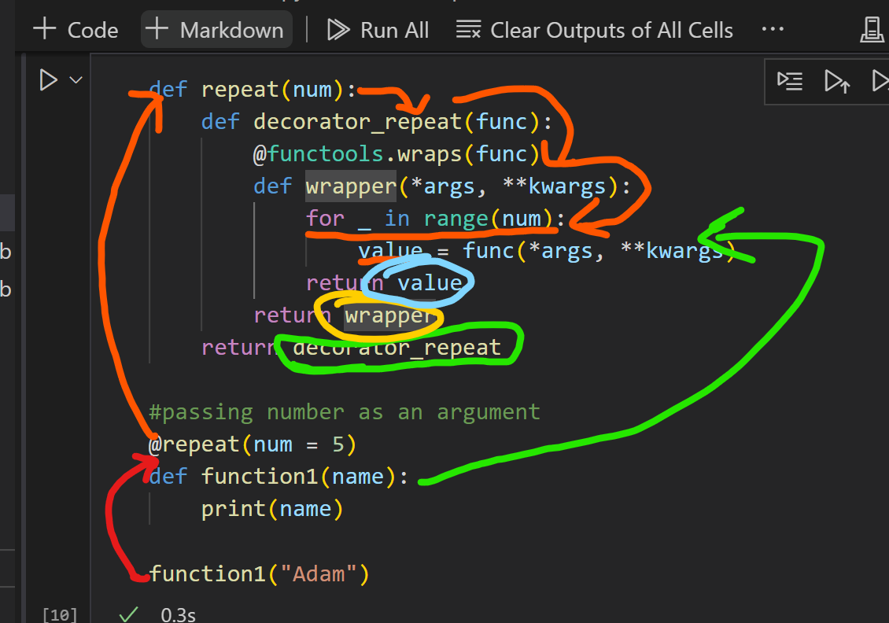

Slide 8
Stateful Decorators
Stateful decorators are used to keep track of the decorator state. Let us consider the example where we are creating a decorator that counts how many times the function has been called.
def count_function(func):
@functools.wraps(func)
def wrapper_count_calls(*args, **kwargs):
wrapper_count_calls.num_calls += 1
print(f"Call {wrapper_count_calls.num_calls} of {func.__name__!r}")
return func(*args, **kwargs)
wrapper_count_calls.num_calls = 0
print("Out of count function")
return wrapper_count_calls
@count_function
def say_hello():
print("Hello")
a = 10 + 20
print(a)
say_hello()
say_hello()
In the above program, the state represented the number of calls of the function stored in .num_calls on the wrapper function. When we call say_hello() it will display the number of the call of the function.

Slide 9
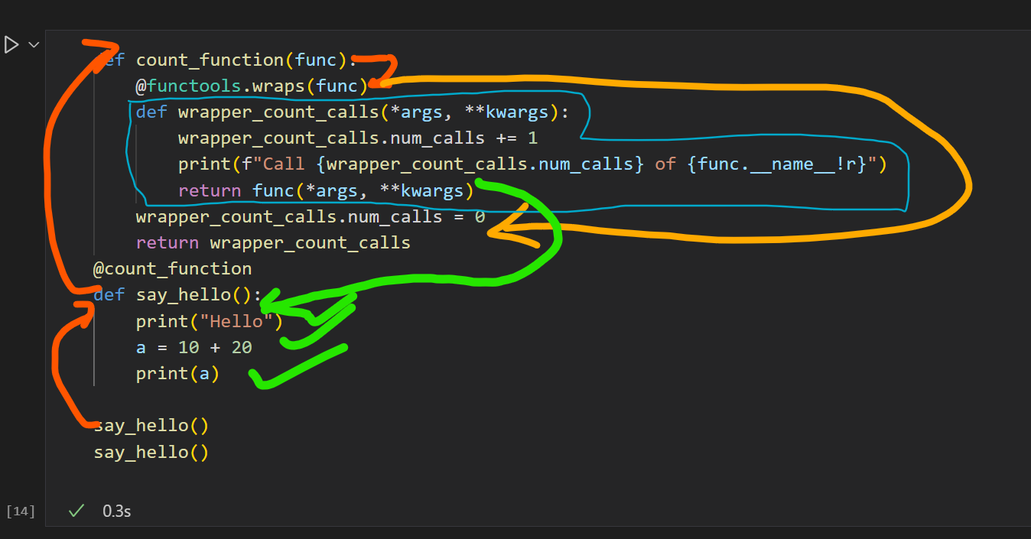

Slide 10
Classes as Decorators
The classes are the best way to maintain state. In this section, we will learn how to use a class as a decorator. Here we will create a class that contains __init__() and take func as an argument. The class needs to be callable so that it can stand in for the decorated function.
To making a class callable, we implement the special __call__() method.
The __init__() method stores a reference to the function and can do any other required initialization.
class MyDecorator:
def __init__(self, function):
print("Inside __init__")
self.function = function
def __call__(self, *args, **kwargs):
print("Inside __call__")
self.function(*args, **kwargs)
print("Exit __call__")
@MyDecorator
def function(name, message = "Good day to you, "):
print(f"{message} - {name}")
function("Adam")

Slide 11
Classes as Decorators
Using class as decorator but with a return statement
class SquareDecorator:
def __init__(self, function):
print("Inside __init__")
self.function = function
def __call__(self, *args, **kwargs):
print("Inside __call__")
result = self.function(*args, **kwargs)
print("Exit __call__")
return result
@SquareDecorator
def get_square(n):
print(f"The square of {n} is - ")
return n*n
print(f"Square of number is : {get_square(5)}")

Slide 12
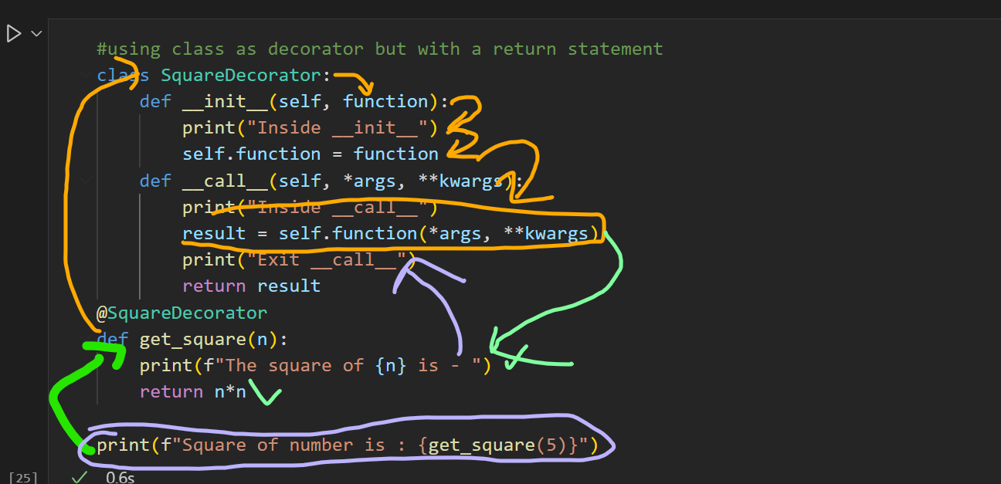

Slide 13
Classes as Decorators
Decorator to find the execution time
from time import time
class Timer:
def __init__(self, func):
self.function = func
def __call__(self, *args, **kwargs):
start_time = time()
print("Inside __call__")
result = self.function(*args, **kwargs)
end_time = time()
print(f"Execution time = {end_time - start_time}")
print("Exit __call__")
return result
@Timer
def function1(delay):
from time import sleep
sleep(delay)
function1(5)

